Slide 1
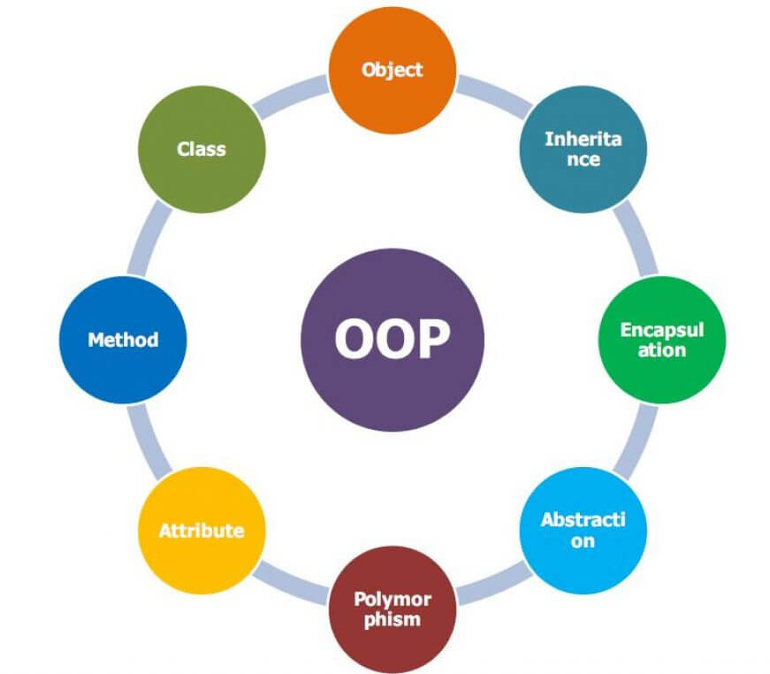
What is Object-Orientation?
By:
Rishav Acharaya
Sudhan Kandel

Slide 2
Table of content
Introduction
Object
Class and Instance
Polymorphism
Inheritance

Slide 3
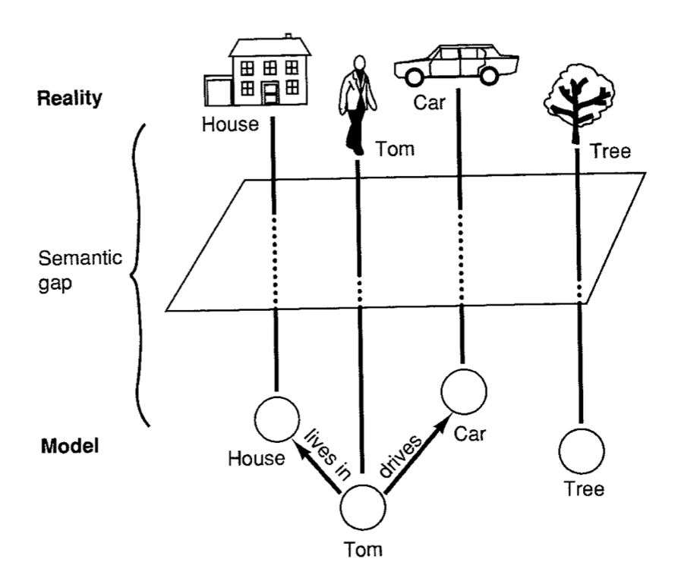
Introduction
Object orientation is a modeling and development methodology based on object-oriented (OO) concepts.
The object-oriented approach, however, focuses on objects that represent abstract or concrete things in the real world.

Slide 4
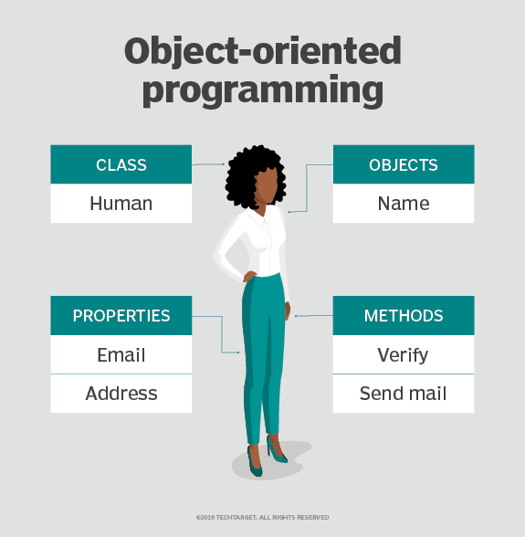
Structure of OOP

Slide 5
What are the benefits of OOP?
Modularity
Reusability
Productivity
Easily upgradable and scalable
Security
Flexibility

Slide 6
What is Object
Objects are instances of classes
They contain data and provides services. The data forms the attributes of the object. The services are known as methods.

Slide 7
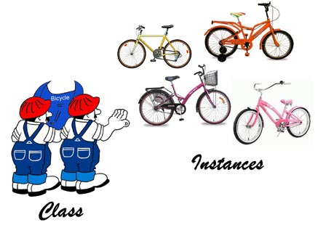
Class and Instance
A class is a user-defined data-type which has data members and member functions.

Slide 8
Polymorphism
Polymorphism is that in which we can perform a task in multiple forms or ways.
It is applied to the functions or methods.
It allows the object to decide which form of the function to implement at compile-time as well as run-time
Type of polymorphism
Compile-time polymorphism(Method Overloading)
Run-time polymorphism (Metthod Overriding)

Slide 9
Cont.
Overloading occurs when two or more methods in one class have the same method name but different parameters.
Overriding occurs when two methods have the same method name and parameters. One of the methods is in the parent class, and the other is in the child class. Overriding allows a child class to provide the specific implementation of a method that is already present in its parent class.​

Slide 10
Inheritance
Inheritance is one in which a new class is created that inherits the properties of the already exist class.
It supports the concept of code reusability and reduce the length of the code.

Slide 11
Type of Inheritance
Single Inheritance
multi-level inheritance
Multiple inheritance
Hybrid inheritance
Hierarchical inheritance

Slide 12
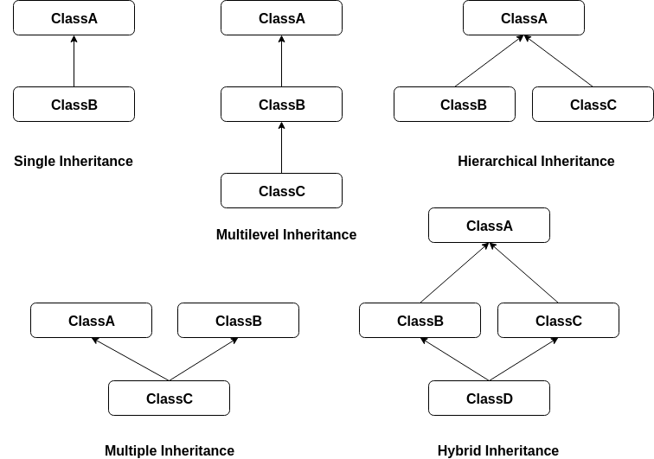
cont.

Slide 13
Thank You

